Slide 1
SSZG 518: Database Design and Applications
Today’s Class
Indexing

Slide 2
Types of Single-Level Indexes
Primary Index
Defined on an ordered data file
The data file is ordered on a key field
Includes one index entry for each block in the data file; the index entry has the key field value for the first record in the block, which is called the block anchor
A similar scheme can use the last record in a block.
A primary index is a nondense (sparse) index, since it includes an entry for each disk block of the data file and the keys of its anchor record rather than for every search value.

Slide 3
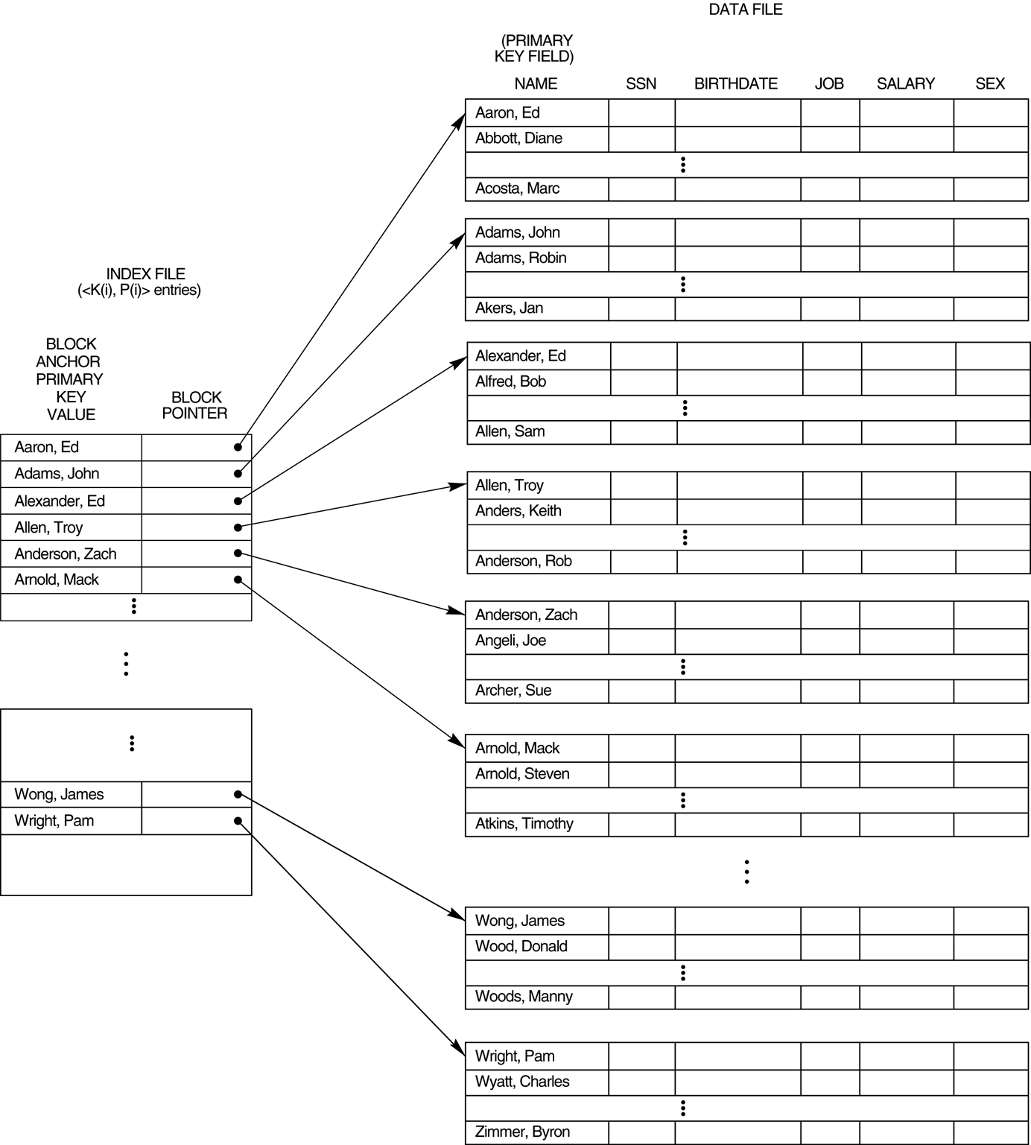
Primary index on the ordering key field of the file

Slide 4
Index Structure
Contains:
Index entries
Can contain the data tuple itself (index and table are integrated in this case); or
Search key value and a pointer to a row having that value; table stored separately in this case – unintegrated index
Location mechanism
Algorithm + data structure for locating an index entry with a given search key value
Index entries are stored in accordance with the search key value
Entries with the same search key value are stored together (hash, B- tree)
Entries may be sorted on search key value (B-tree)

Slide 5
Index Structure
S
Search key
value
Location Mechanism
Location mechanism
facilitates finding
index entry for S
S
Index entries
Once index entry is found, the row can be directly accessed
S, …….

Slide 6
Dense indexes
Every key from the data file is represented
Entries are in the same order as that of the file
Binary search can be used to find the required <key, pointer>
No.of blocks searched ‘log n’ instead of n/2 on an average

Slide 7
Example: 1,000,000 tuples, 10 tuples/4096 byte block, key field 30 bytes, pointer 8 bytes
Data file takes 400MB space
Index file will take 10,000 blocks with100 entries/block
Search will involve at most log10000 = 13 blocks in MM
Memory can also be optimized by keeping only most searched blocks in memory
Hence a record can be retrieved with less than 14 disk I/Os

Slide 8
Sparse indexes
Useful if dense index is too large
Uses less space at the cost of possibly more time to search
Generally a record, usually the first, per block is represented
Sparse index for previous example would take only 1000 blocks, 4MB
But, it can not give quick answer to query ‘does there exist a record with key value K?”
It requires one disk I/O with searching in the block
Search K: find entry with largest key ≤ K

Slide 9
Sparse Vs Dense Index
Dense index: index entry for each data record
Unclustered index must be dense
Clustered index need not be dense
Sparse index: index entry for each block of data file

Slide 10
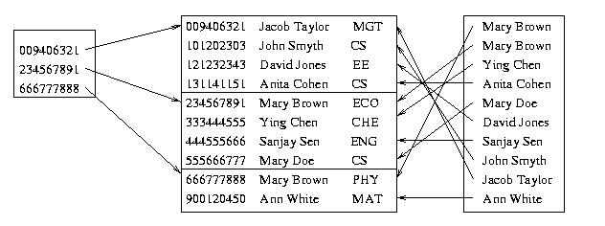
Sparse Vs. Dense Index
Id Name Dept
Sparse,
clustered
index sorted
on Id
data file sorted
on Id
Dense,
unclustered
index sorted
on Name

Slide 11
Clustered Index
Good for range searches
Use location mechanism to locate index entry at start of range
This locates first data record.
Subsequent data records are contiguous if index is clustered (not so if unclustered)
Minimizes page transfers and maximizes likelihood of cache hits

Slide 12
Types of Single-Level Indexes
Secondary Index
A secondary index provides a secondary means of accessing a file for which some primary access already exists.
The secondary index may be on a field which is a candidate key and has a unique value in every record, or a nonkey with duplicate values.
The index is an ordered file with two fields.
The first field is of the same data type as some nonordering field of the data file that is an indexing field.
The second field is either a block pointer or a record pointer. There can be many secondary indexes (and hence, indexing fields) for the same file.
Includes one entry for each record in the data file; hence, it is a dense index

Slide 13
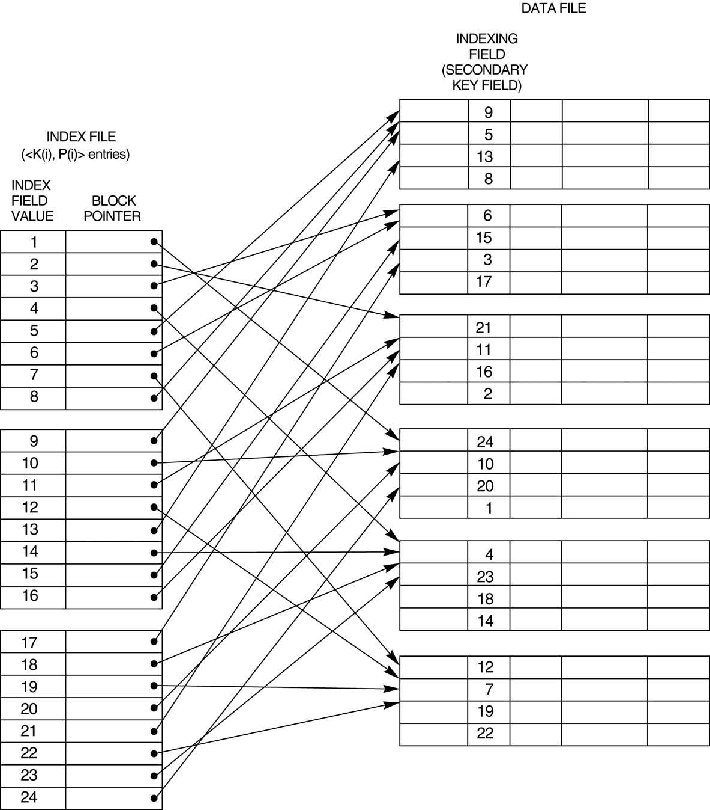
A dense secondary index (with block pointers) on a nonordering key field of a file.

Slide 14
Secondary indexes
SELECT name, address
FROM MovieStar
WHERE birthdate=DATE ‘1952-01-01’
CREATE INDEX BDIndex ON MovieStar(birthdate);
Secondary indexes are always ‘dense’
Second level index could be ‘sparse’
Secondary indexes are usually with duplicates

Slide 15
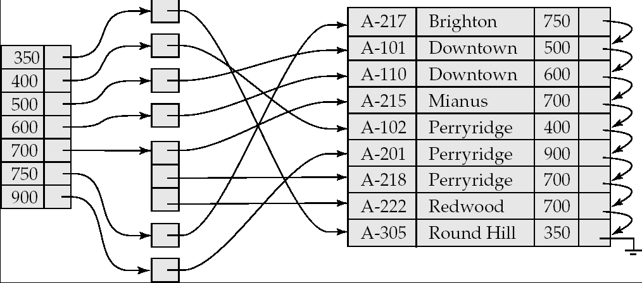
Secondary Indices Example
Secondary index on balance field of account
Index record points to a bucket that contains pointers to all the actual records with that particular search-key value.

Slide 16
Multi-level indexes
When an index is too large with even binary search taking too many disk I/Os
Define second level index: index on index
This can continue to multi-level index structure
Second and higher level indexes must be sparse
Second level index in previous example would take only 10 blocks, 40KB
Search involves 2 disk I/Os and searching in the block

Slide 17
Multilevel Index
If an index does not fit in memory, access becomes expensive.
To reduce number of disk accesses to index records, treat the index kept on disk as a sequential file and construct a sparse index on it.
outer index – a sparse index on main index
inner index – the main index file
If even outer index is too large to fit in main memory, yet another level of index can be created, and so on.
Indices at all levels must be updated on insertion or deletion from the file.

Slide 18
Multilevel Index (Cont.)
outer index
inner index
Data
Block 0
Index
Block 0


Data
Block 1

Index
Block 1





Slide 19
Multi-level indexes
When an index is too large with even binary search taking too many disk I/Os
Define second level index: index on index
This can continue to multi-level index structure
Second and higher level indexes must be sparse
Second level index in previous example would take only 100 blocks, 400KB
Search involves 6 disk I/Os and searching in the block

Slide 20
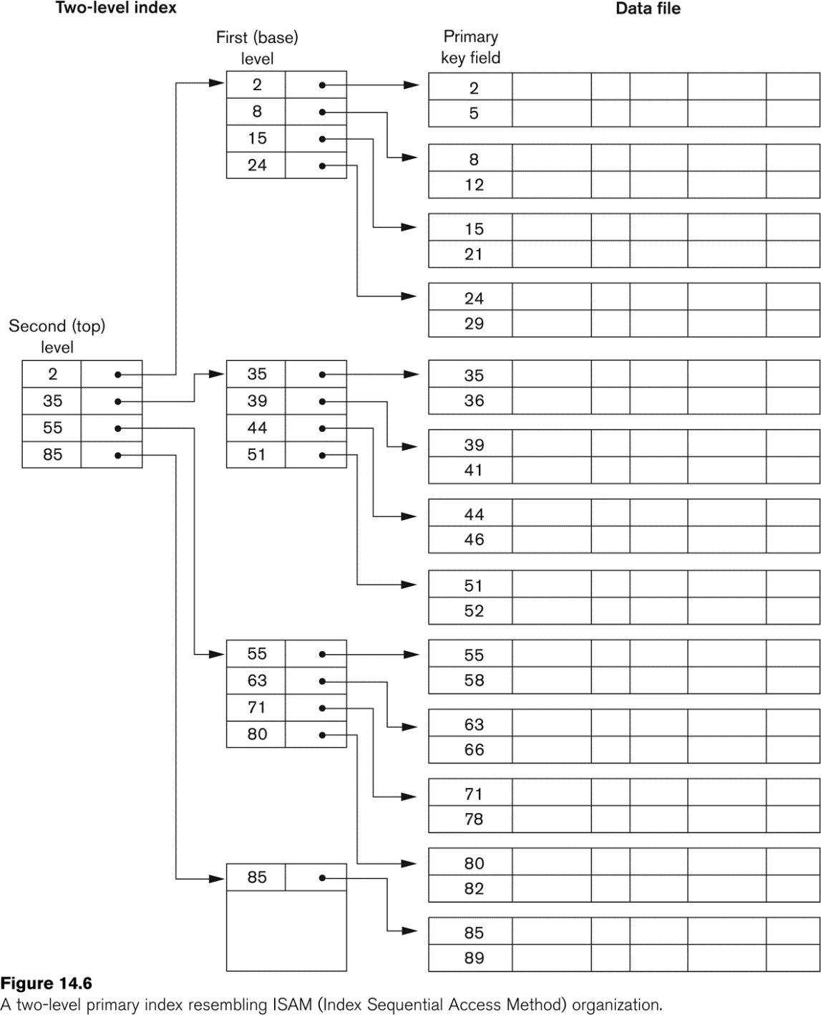
A Two-level Primary Index

Slide 21
Estimating Costs
For simplicity we estimate the cost of an operation by counting the number of blocks that are read or written to disk.
We ignore the possibility of blocked access which could significantly lower the cost of I/O.
We assume that each relation is stored in a separate file with B blocks and R records per block.

Slide 22
Choosing Indexing Technique
Five Factors involved when choosing the indexing technique:
access type
access time
insertion time
deletion time
space overhead

Slide 23
Indexing Definitions
Access type is the type of access being used.
Access time - time required to locate the data.
Insertion time - time required to insert the new data.
Deletion time - time required to delete the data.
Space overhead - the additional space occupied by the added data structure.

Slide 24
Index Evaluation Metrics
Access time for:
Equality searches – records with a specified value in an attribute
Range searches – records with an attribute value falling within a specified range.
Insertion time
Deletion time
Space overhead

Slide 25
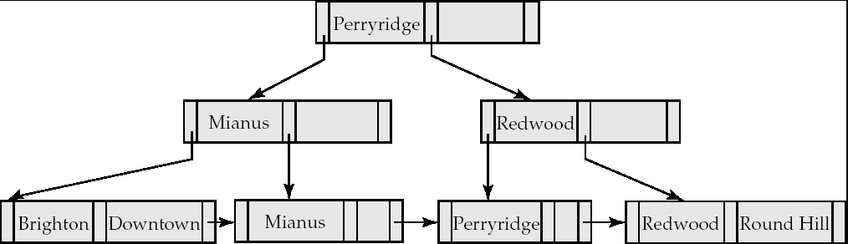
B⁺-Tree Index
A B⁺-tree is a rooted tree satisfying the following properties:
All paths from root to leaf are of the same length
Each node that is not a root or a leaf has between ⎡n/2⎤ and n children. [Non leaf node]
A leaf node has between ⎡(n–1)/2⎤ and n–1 values
Special cases:
If the root is not a leaf, it has at least 2 children.
If the root is a leaf (that is, there are no other nodes in the tree), it can have between 0 and (n–1) values.

Slide 26
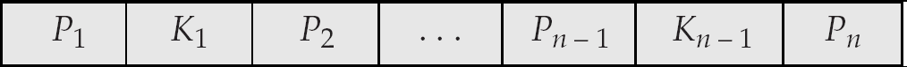
B⁺-Tree Node Structure
Typical node
K_{i} are the search-key values
P_{i} are pointers to children (for non-leaf nodes) or pointers to records or buckets of records (for leaf nodes).
The search-keys in a node are ordered
K₁ < K₂ < K₃ < . . . < K_{n–1}

Slide 27
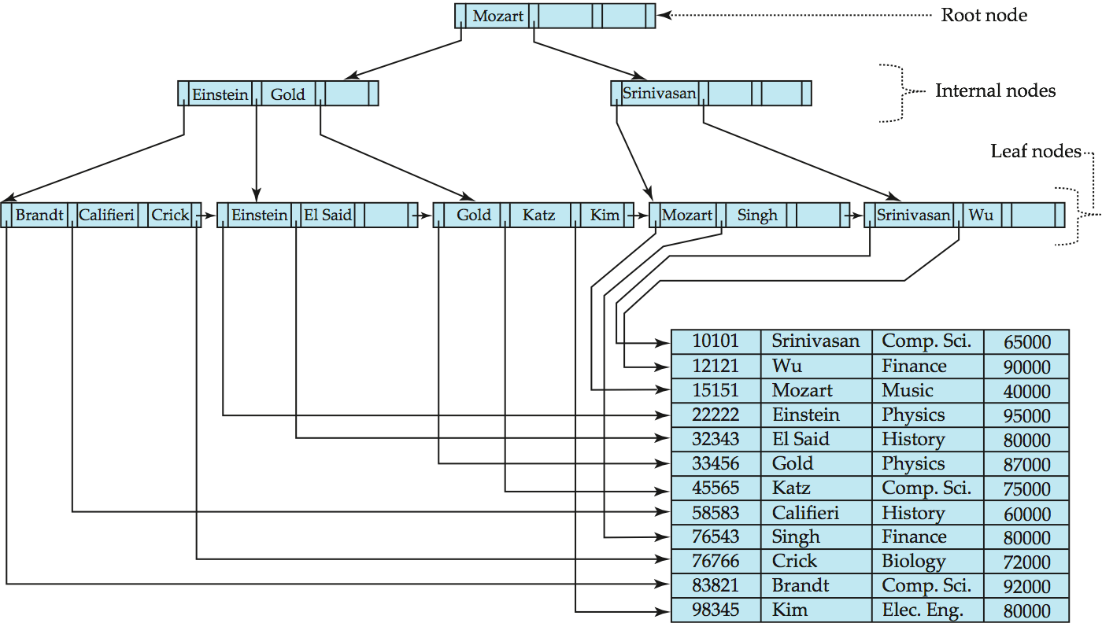
Example of B⁺-Tree

Slide 28
Updates on B⁺-Trees: Insertion (Cont.)
Splitting a leaf node:
take the n (search-key value, pointer) pairs (including the one being inserted) in sorted order. Place the first ⎡n/2⎤ in the original node, and the rest in a new node.
let the new node be p, and let k be the least key value in p. Insert (k,p) in the parent of the node being split.
If the parent is full, split it and propagate the split further up.
Splitting of nodes proceeds upwards till a node that is not full is found.
In the worst case the root node may be split increasing the height of the tree by 1.
Result of splitting node containing Brandt, Califieri and Crick on inserting Adams
Next step: insert entry with (Califieri,pointer-to-new-node) into parent

Slide 29
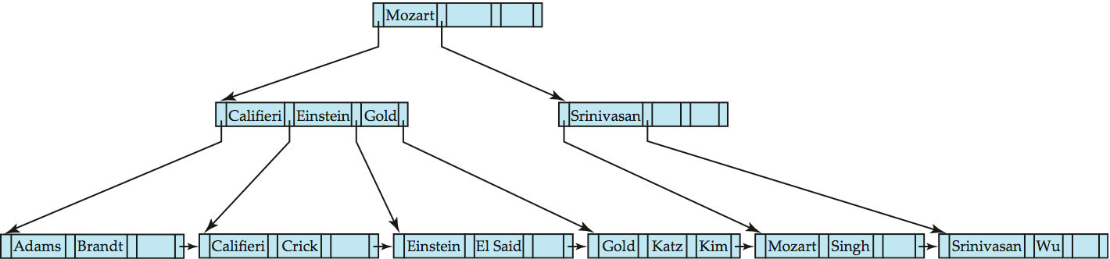
B⁺-Tree Insertion
B⁺-Tree before and after insertion of “Adams”

Slide 30
Insertion in B⁺-Trees (Cont.)
Splitting a non-leaf node: when inserting (k,p) into an already full internal node N
Copy N to an in-memory area M with space for n+1 pointers and n keys
Insert (k,p) into M
Copy P₁,K₁, …, K _{⎡n/2⎤-1},P _{⎡n/2⎤} from M back into node N
Copy P_{⎡n/2⎤+1},K _{⎡n/2⎤+1},…,K_{n},P_{n+1} from M into newly allocated node N’
Insert (K _{⎡n/2⎤},N’) into parent N
Read pseudocode in book!
Califieri
Adams Brandt Califieri Crick
Adams Brandt
Crick

Slide 31
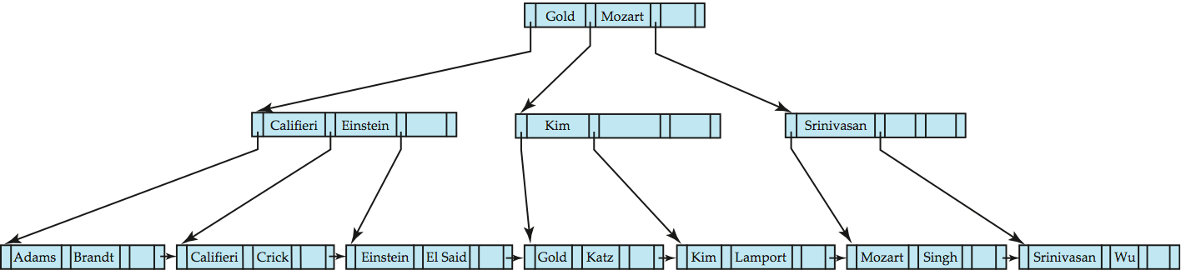
B⁺-Tree before and after insertion of “Lamport”

Slide 32
B+ Tree: Most Widely Used Index
Insert/delete at log _{F} N cost; keep tree height-balanced. (F = fanout, N = # leaf pages)
Minimum 50% occupancy (except for root). Each node contains n <= m <= 2n entries. The parameter n is called the order of the tree.
Supports equality and range-searches efficiently.
Index Entries
(Direct search)
Data Entries
("Sequence set")
Notes:
9

Slide 35
Dynamic Multilevel Indexes Using B-Trees and B+-Trees
Because of the insertion and deletion problem, most multi-level indexes use B-tree or B+-tree data structures, which leave space in each tree node (disk block) to allow for new index entries
These data structures are variations of search trees that allow efficient insertion and deletion of new search values.
In B-Tree and B+-Tree data structures, each node corresponds to a disk block
Each node is kept between half-full and completely full

Slide 36
Dynamic Multilevel Indexes Using B-Trees and B+-Trees (contd.)
An insertion into a node that is not full is quite efficient; if a node is full the insertion causes a split into two nodes
Splitting may propagate to other tree levels
A deletion is quite efficient if a node does not become less than half full
If a deletion causes a node to become less than half full, it must be merged with neighboring nodes

Slide 37
Difference between B-tree and B+-tree
In a B-tree, pointers to data records exist at all levels of the tree
In a B+-tree, all pointers to data records exists at the leaf-level nodes
A B+-tree can have less levels (or higher capacity of search values) than the corresponding B-tree

Slide 38
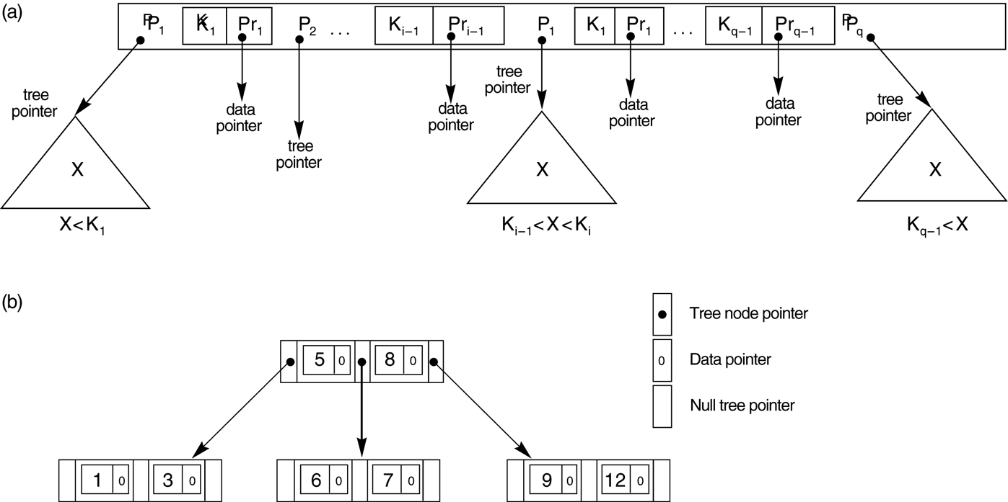
B-tree structures. (a) A node in a B-tree with q – 1 search values. (b) A B-tree of order p = 3. The values were inserted in the order 8, 5, 1, 7, 3, 12, 9, 6.

Slide 39
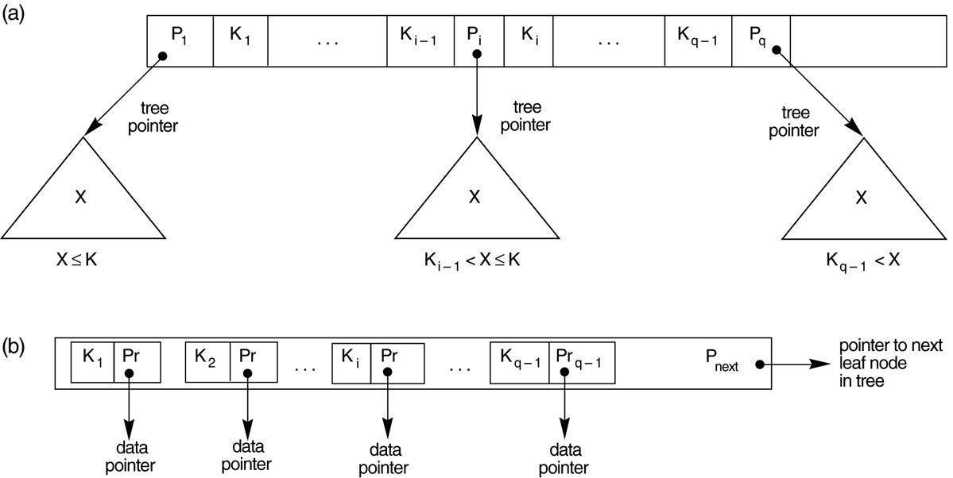
The nodes of a B+-tree. (a) Internal node of a B+-tree with q –1 search values. (b) Leaf node of a B+-tree with q – 1 search values and q – 1 data pointers.

Slide 40
Observations about B⁺-trees
Since the inter-node connections are done by pointers, “logically” close blocks need not be “physically” close.
The non-leaf levels of the B⁺-tree form a hierarchy of sparse indices.
The B⁺-tree contains a relatively small number of levels
Level below root has at least 2* ⎡n/2⎤ values
Next level has at least 2* ⎡n/2⎤ * ⎡n/2⎤ values
.. etc.
If there are K search-key values in the file, the tree height is no more than ⎡ log_{⎡n/2⎤}(K)⎤
thus searches can be conducted efficiently.
Insertions and deletions to the main file can be handled efficiently, as the index can be restructured in logarithmic time.

Slide 41
B+ Trees in Practice
Typical order: 100. Typical fill-factor: 67%.
average fanout = 133
Typical capacities:
Height 4: 133⁴ = 312,900,700 records
Height 3: 133³ = 2,352,637 records
Can often hold top levels in buffer pool:
Level 1 = 1 page = 8 Kbytes
Level 2 = 133 pages = 1 Mbyte
Level 3 = 17,689 pages = 133 MBytes

Slide 42
Inserting a Data Entry into a B+ Tree
Find correct leaf L.
Put data entry onto L.
If L has enough space, done!
Else, must split L (into L and a new node L2)
Redistribute entries evenly, copy up middle key.
Insert index entry pointing to L2 into parent of L.
This can happen recursively
To split index node, redistribute entries evenly, but push up middle key. (Contrast with leaf splits.)
Splits “grow” tree; root split increases height.
Tree growth: gets wider or one level taller at top.
Notes:
6

Slide 43
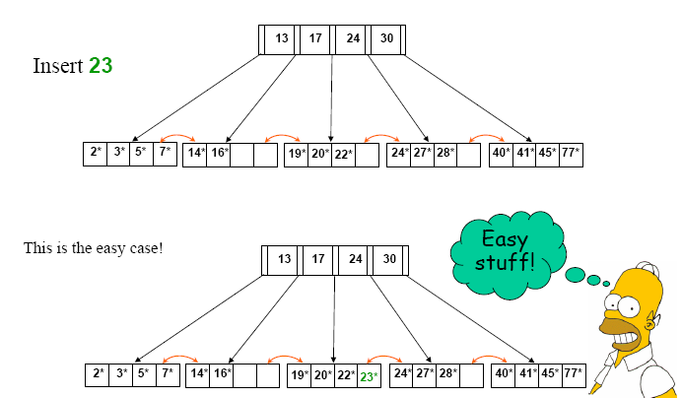

Slide 46
Inserting 8* into Example B+ Tree
Observe how minimum occupancy is guaranteed in both leaf and index pg splits.
Note difference between copy-up and push-up; be sure you understand the reasons for this.
Entry to be inserted in parent node.
5
(Note that 5 is
s copied up and
continues to appear in the leaf.)
2*
3*
5*
7*
8*
Entry to be inserted in parent node.
17
(Note that 17 is pushed up and only
appears once in the index. Contrast
this with a leaf split.)
5
13
24
30
Notes:
12

Slide 47
Example B+ Tree After Inserting 8*
Root
17
5
13
24
30
2*
3*
5*
7*
8*
14*
16*
19*
20*
22*
24*
27*
29*
33*
34*
38*
39*
Notice that root was split, leading to increase in height.
In this example, we can avoid split by re-distributing entries; however, this is usually not done in practice.
Notes:
13

Slide 48
Deleting a Data Entry from a B+ Tree
Start at root, find leaf L where entry belongs.
Remove the entry.
If L is at least half-full, done!
If L has only d-1 entries,
Try to re-distribute, borrowing from sibling (adjacent node with same parent as L).
If re-distribution fails, merge L and sibling.
If merge occurred, must delete entry (pointing to L or sibling) from parent of L.
Merge could propagate to root, decreasing height.
Notes:
14

Slide 49
Example Tree After (Inserting 8*, Then) Deleting 19* and 20* ...
Root
17
5
13
27
30
2*
3*
5*
7*
8*
14*
16*
22*
24*
27*
29*
33*
34*
38*
39*
Deleting 19* is easy.
Deleting 20* is done with re-distribution. Notice how middle key is copied up.
Notes:
15

Slide 50
... And Then Deleting 24*
Must merge.
Observe `toss’ of index entry (on right), and `pull down’ of index entry (below).
30
22*
27*
29*
33*
34*
38*
39*
Root
5
13
17
30
2*
3*
5*
7*
8*
14*
16*
22*
27*
29*
33*
34*
38*
39*
Notes:
16

Slide 51
Index Definition in SQL
Create an index
create index <index-name> on <relation-name> (<attribute-list>)
E.g.: create index b-index on branch(branch_name)
Use create unique index to indirectly specify and enforce the condition that the search key is a candidate key is a candidate key.
Not really required if SQL unique integrity constraint is supported
To drop an index
drop index <index-name>
Most database systems allow specification of type of index, and clustering.

